Slide 1


Kusto Query Language: Getting Started
Introduction to the Kusto Query Language
Robert C. Cain
Owner, Arcane Training and Consulting
@ArcaneCode www.arcanecode.com
Notes:
Welcome to Kusto Query Language: Getting Started. I’m Robert Cain, owner of Arcane Training and Consulting, and I’ll be your host for this course.

Slide 2
Introduction to KQL
Who should be using KQL
What is the purpose of KQL
Where should KQL be used
Terms and Definitions
Table Groups
Tables
Columns
The Log Analytics Demo Environment
Overview
Notes:
This course will serve as your introduction to the Kusto Query Language, or KQL for short.
We’ll start with a conversation on who the target audience is for the Kusto language.
Next, we’ll talk about the purpose of KQL, <CLICK>, as well as where KQL can be used.
After that we’ll need to come up to speed on some fundamental terminology. These include terms like Table groups <CLICK>, tables, <CLICK> columns, and more.
Finally, we’ll take a look at the Log Analytics Demo Environment that we’ll be using in this and future courses in this series.

Slide 3



Who Should Use KQL
IT Personnel
Data Analysts
Report Writers
Notes:
So, who should be using KQL?
First are your IT Personnel. As you’ll see in this series, IT Personnel can use Kusto to query that status of servers and other services hosted on on the Azure platform.
Next are Data Analysts. They can use KQL to query business related data to gain insights into the health of the corporation.
Finally, we have Report Writers. Tools such as PowerBI can connect to Azure to query data. Using KQL, Report Writers can author reports that can be used by everyone in the company.

Slide 4
“Kusto Query Language is a powerful tool to explore your data and discover patterns, identify anomalies and outliers, create statistical modeling, and more.”
Microsoft KQL Overview Documentation
Notes:
So what is the purpose of the Kusto Query Language? Well to quote Microsoft’s own documentation, Kusto Query Language is a powerful tool to explore your data and discover patterns, identify anomalies and outliers, create statistical modeling, and more.
Simply put, the Kusto Query Language provides commands to sift through large, and I mean really really large, huge, massive, ginormous quantities of data to find answers to your questions. These questions may be business related, pertaining to the health of your enterprise. Or, as in the examples in this course, questions related to the state of your IT infrastructure.

Slide 5
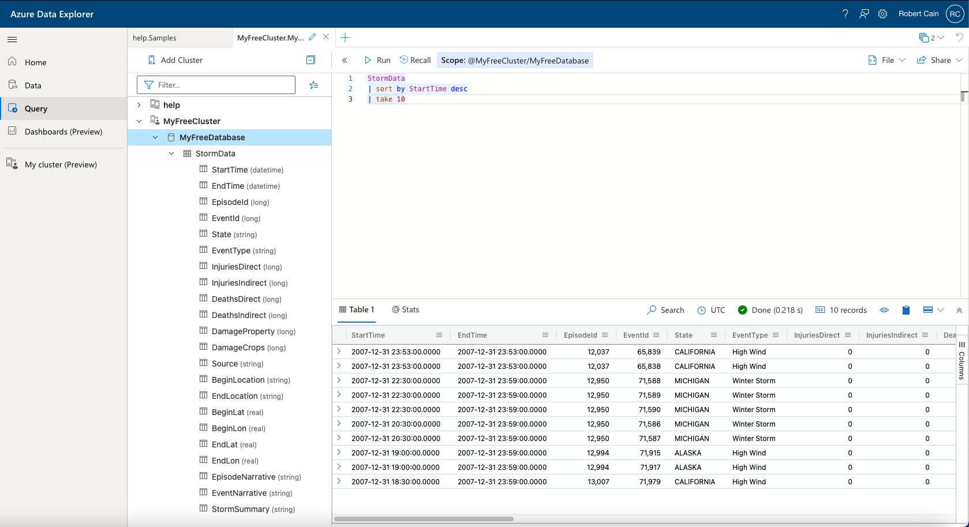
Azure Data Explorer
Notes:
So at this point we’ve learned there is a cool query language called Kusto, and have identified who should be using it. The next logical question is, where can Kusto be used?
The first place is the Azure Data Explorer. With Azure you can create your own data clusters, then explore them with the Azure Data Explorer using KQL.

Slide 6
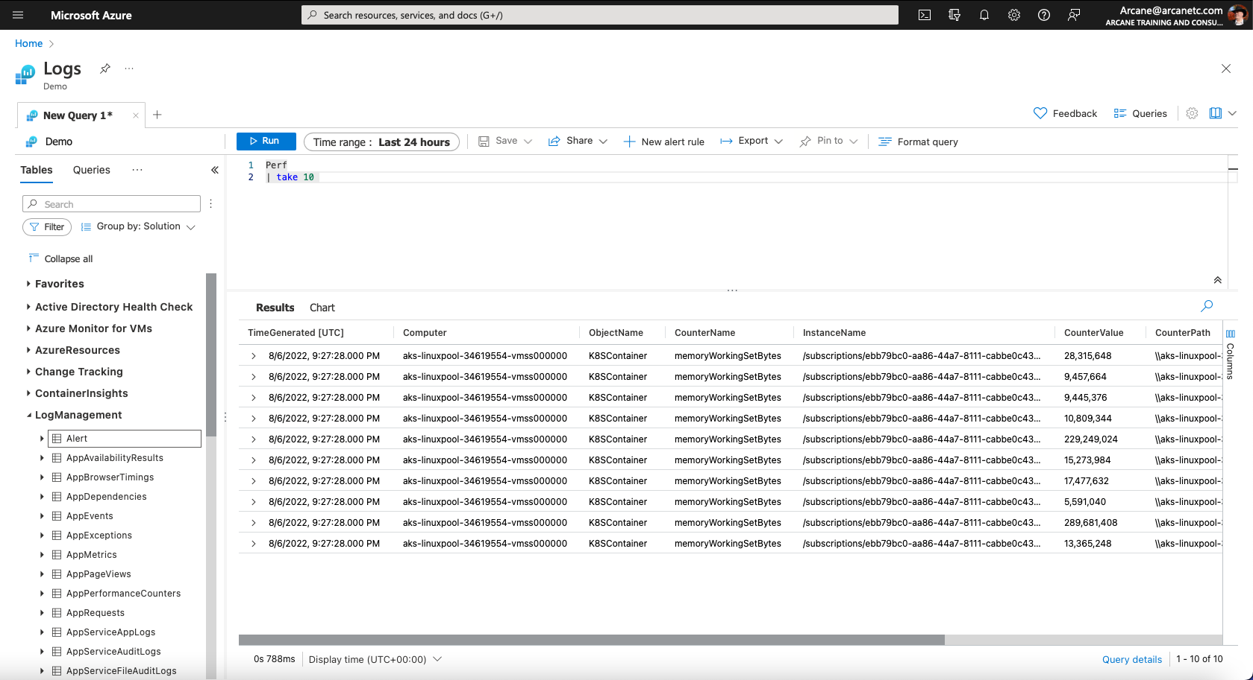
Monitoring – Log Analytics
Notes:
Next, Azure provides a suite of monitoring tools to allow your IT staff to monitor the health of your Azure based IT infrastructure. Many of these tools allow you to use KQL to query the data they collect. The monitoring tool we’ll use for this course is the Log Analytics environment, which you can see here.

Slide 7
Up Next:
Terms and Definitions Used With KQL
Notes:
In our next module, we’ll be covering some basic terms and definitions used with KQL

Slide 8
Terms and Definitions Used With KQL
Robert C. Cain
Owner, Arcane Training and Consulting
@ArcaneCode www.arcanecode.com
Notes:
In this module we’ll learn some of the terms used with KQL and define them, within the context of the environments they are used in.

Slide 9
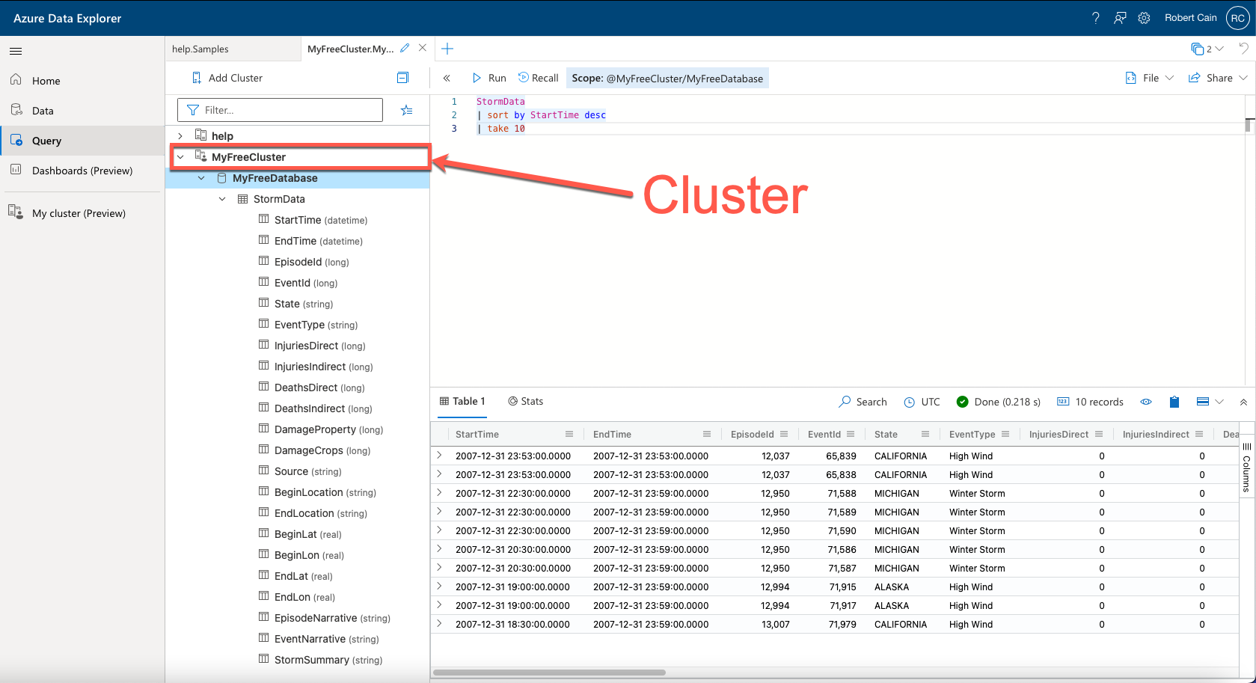
Notes:
For this part, let’s take a look at the Azure Data Explorer.
We’ve connected the Azure Data Explorer to a Cluster. Azure allows us to create our own Clusters to store data. You can think of a cluster like a database server. Be aware though, that while the terminology in Kusto shares some of the same terminology as SQL Server, they are vastly different under the hood.
If you look on the left, in the data pane portion of the UI, you can see I’ve connected to a cluster that I created named MyFreeCluster.

Slide 10
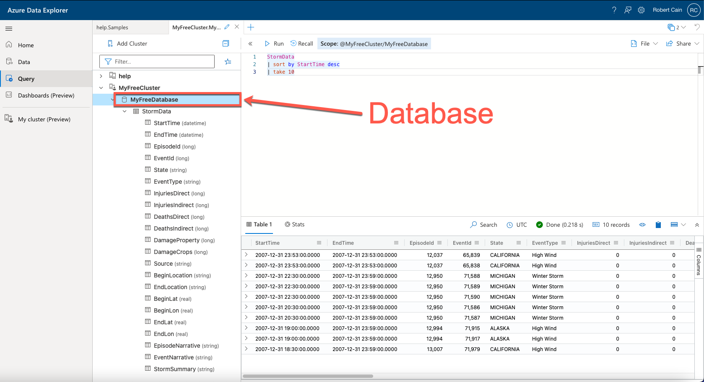
Notes:
Within a cluster, we can create one or more databases. Here, I’ve created a single database, MyFreeDatabase.

Slide 11
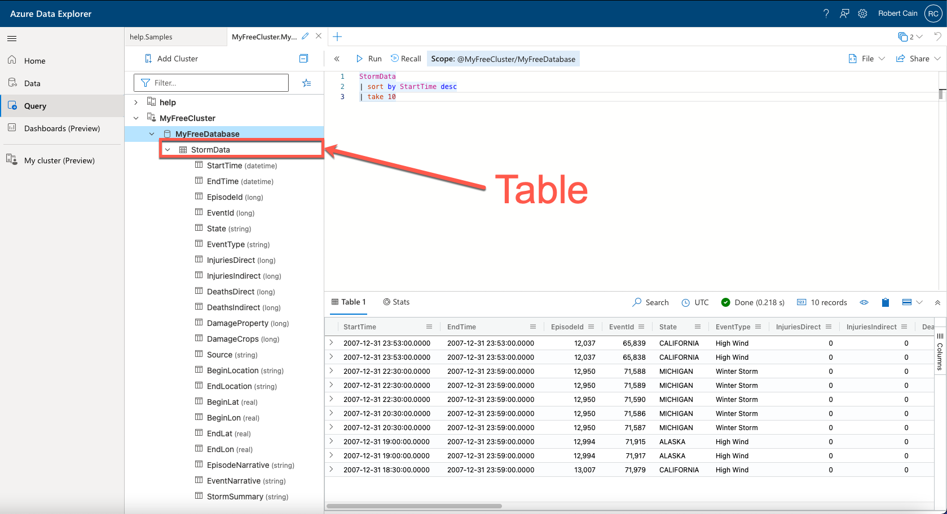
Notes:
Within a database, we can have one or more tables. In this example I have a single table named StormData.

Slide 12
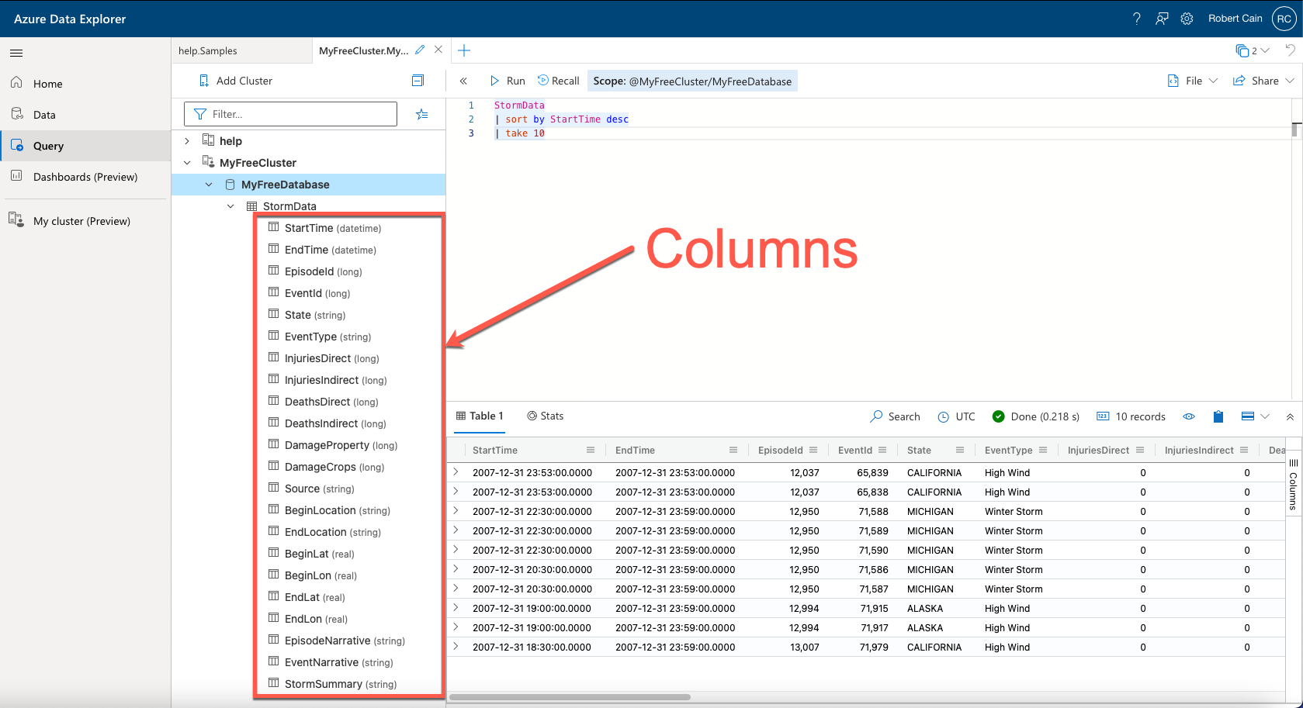
Notes:
Just as with a SQL Server table, a table in an Azure Cluster can have multiple columns.

Slide 13
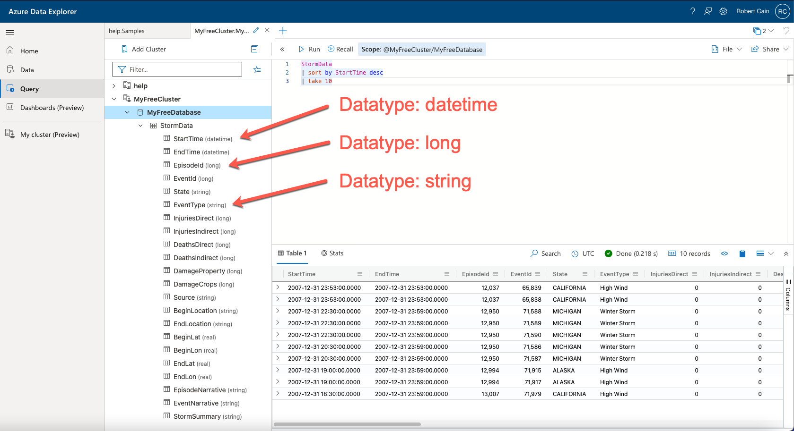
Notes:
Note that to the right of each column name, within parathesis, is the data type of the column. I’ve pointed out a few in this example, but there are quite a variety of data types available.

Slide 14
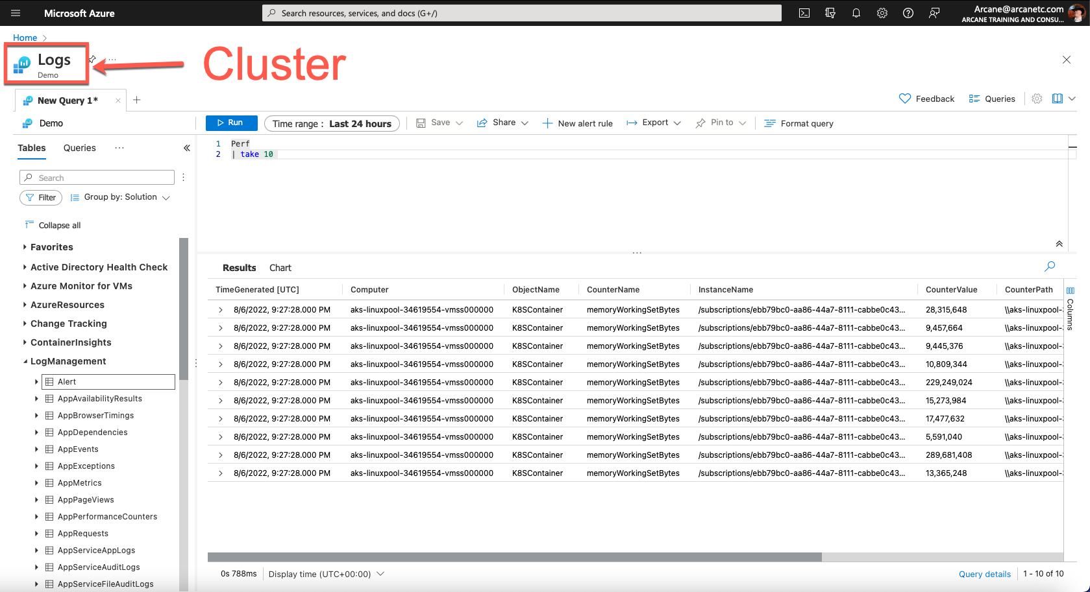
Notes:
Now let's shift to one of the prebuilt monitoring tools provided by Azure, in this case Log Analytics. It’s not entirely clear from the user interface, but the name of the cluster is Logs. This was determined by Microsoft when they built this particular log analytics monitoring tool.

Slide 15
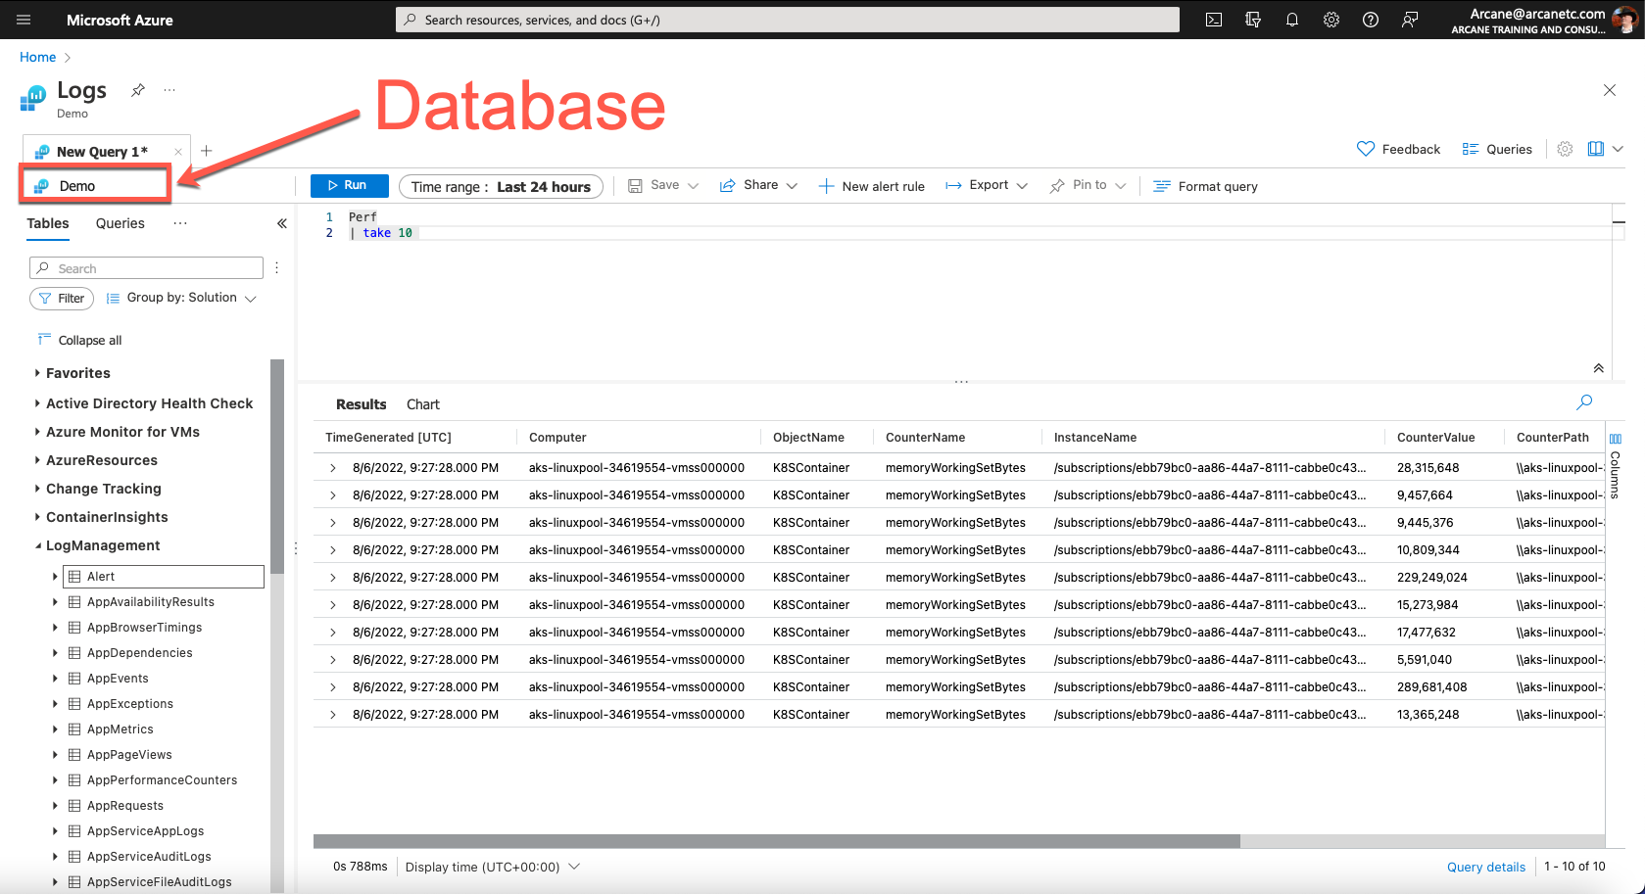
Notes:
Our logs cluster has one database in it, Microsoft determines the name from your Azure environment. Here we are accessing the Demo environment that was built by Microsoft, thus the “Demo” name.

Slide 16
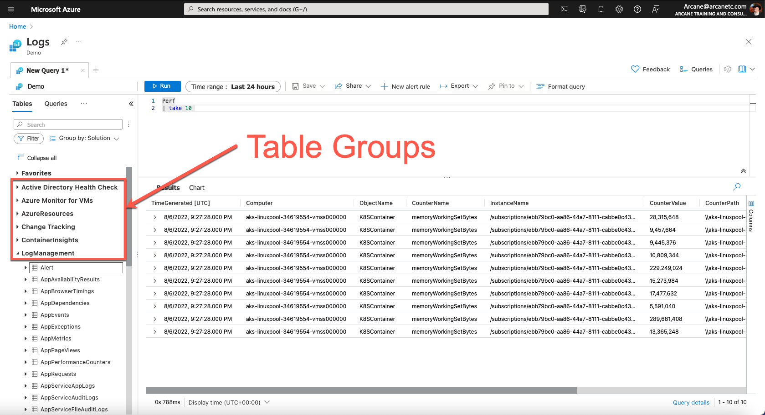
Notes:
A nice feature Microsoft built into the monitoring tools is Table Groups. These provide a way to group our tables together by different criteria.

Slide 17
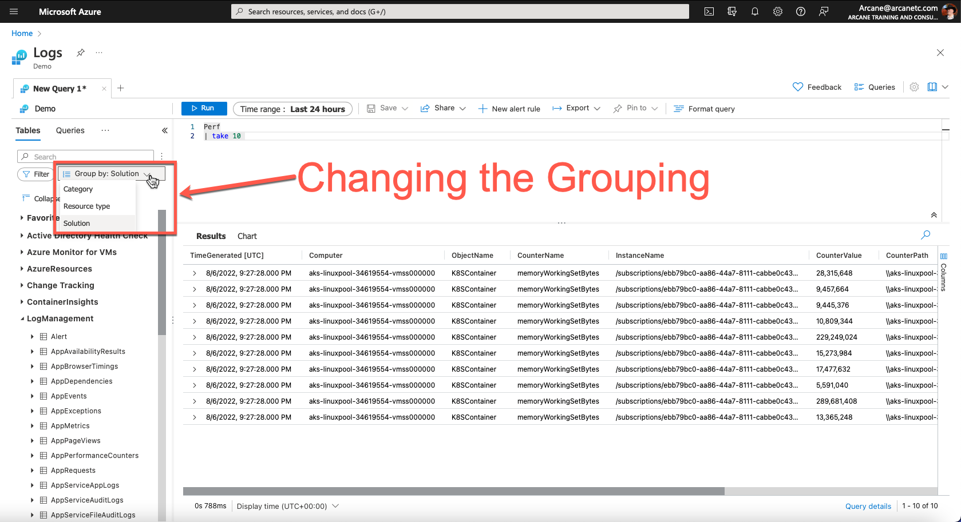
Notes:
You can change the grouping method by using the drop down above the table group list. By default, Log Monitoring uses the Solution group, but you can pick from the other types to see how they are organized.

Slide 18
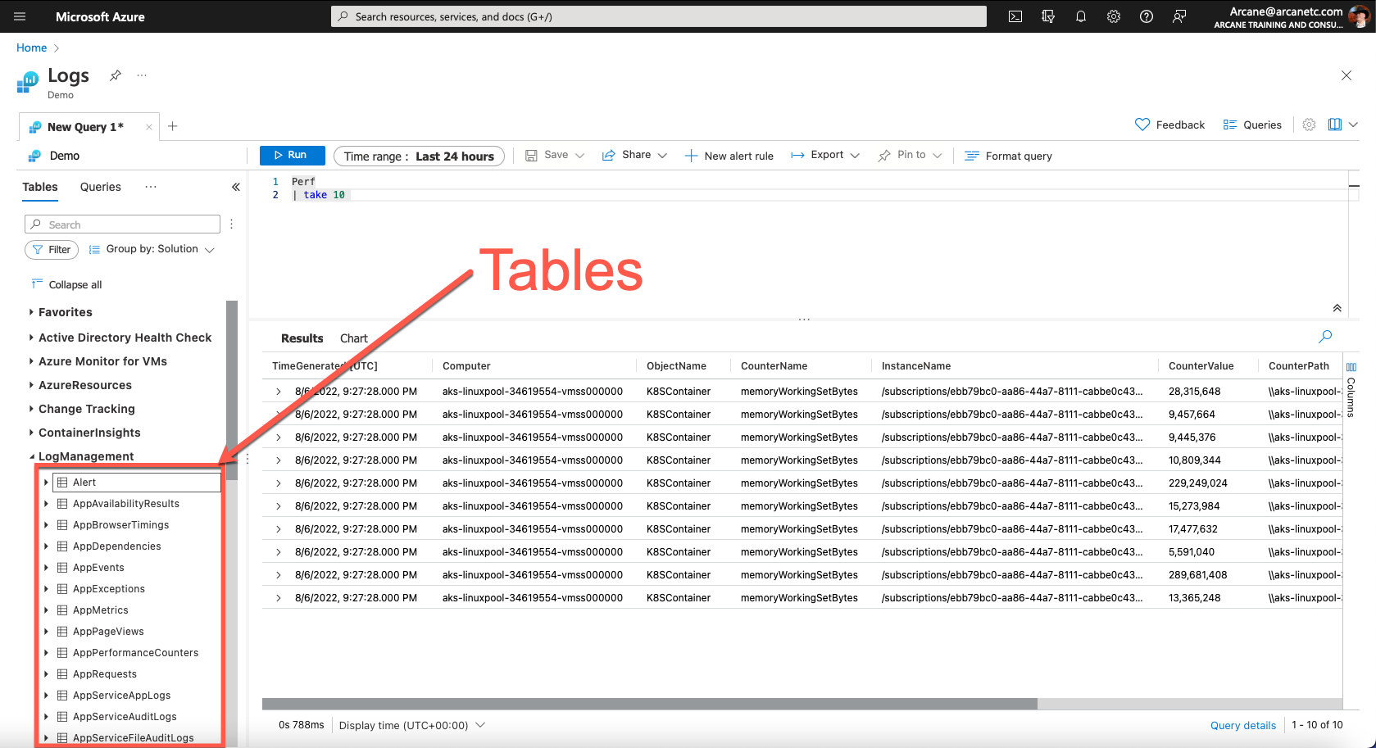
Notes:
Here I’ve outlined the tables that are in the Log Management group, at least the tables that appear on screen. There are actually quite a few. I could see the tables in other groups by simply clicking on the arrow beside the group name.

Slide 19
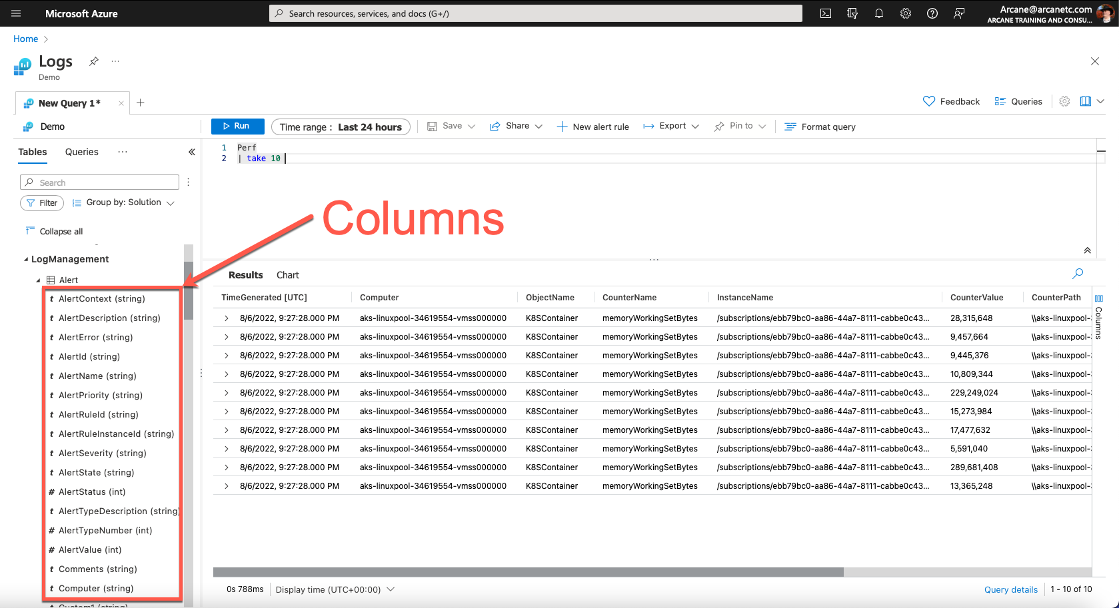
Notes:
Here I expanded the Alert table, and now we can see the columns that are part of the Alert table. As with the Azure Data Explorer, the data type for each column is displayed beside it in parenthesis.
For the rest of the course, we’ll be focusing on the Log Analytics interface for performing our Kusto learning. I wanted to display the Log Analytics as well as the Azure Data Explorer interfaces so you could learn about the different database objects types and see how they are displayed in the context of their respective UIs.
And again, as a final note let me remind you that while on the surface these objects appear similar to what you may see in a more traditional SQL Server database, under the hood they are very different things.

Slide 20
Up Next:
The Log Analytics Demo Environment
Notes:
It’s time to have some fun, in the next module we’ll get to see the Log Analytics demo environment in action!

Slide 21
The Log Analytics Demo Environment
Robert C. Cain
Owner, Arcane Training and Consulting
@ArcaneCode www.arcanecode.com
Notes:
It’s time to see KQL in action, inside the Log Analytics Demo environment.

Slide 22
Free Log Analytics Demo Environment
https://aka.ms/LADemo
https://portal.azure.com/#view/Microsoft_Azure_Monitoring_Logs/DemoLogsBlade
Notes:
For this demo, we’ll be using the free log analytics demo environment. You can access it yourself by using the shortcut aka.ms/LADemo, or the full URL listed below.

Slide 23
Up Next:
Conclusion
Notes:
In our next and final module, we’ll recap what we’ve covered as well as discuss some next steps in your KQL learning journey.

Slide 24
Conclusion
Robert C. Cain
Owner, Arcane Training and Consulting
@ArcaneCode www.arcanecode.com
Notes:
Congratulations, you’ve reached the end of this course, an introduction to the Kusto Query Language.

Slide 25
Introduction to KQL
Who should be using KQL
What is the purpose of KQL
Where should KQL be used
Terms and Definitions
Table Groups
Tables
Columns
The Log Analytics Demo Environment
Summary
Notes:
We began the course by covering the target audience for KQL, namely the IT Staff, data analysts, and report authors.
We then had a brief discussion about the purpose of KQL
Following this we saw two places where KQL can be used, the Azure Data Explorer and the Azure monitoring tools, in this example Log Analytics.
<CLICK>
The definition of data terms in Kusto came next, and they were covered in the context of the user interfaces.
<CLICK>
Finally, we’ll looked at the Log Analytics Demo Environment that we’ll be using in this and future courses in this series.

Slide 26
Next Steps
Kusto Query Language Learning Path
Demos and Slides
Notes:
This course is part of a Kusto Query Language Learning Path, I’d suggest moving on to the next course in the series as they become available.
In addition, don’t forget the demos and slides, along with my presentation notes, are available for download on the same page you are viewing this course.

Slide 27
More information
https://arcanecode.com
https://github.com/arcanecode
Notes:
For more information you can check out my blog at arcanecode.com, where I’ve been doing a multi year series on the Kusto Query Language.
I also have several KQL related repositories, loaded with examples, available at my github site github.com/arcanecode.

Slide 28
Thanks For Watching!
Notes:
Thanks for watching, and I hope to see you again soon in one of my many other courses here on Pluralsight.

